Slide 1

Donate the blood
Present by JABIR, SUMIT, POOJA, ANISUL

Slide 2
AGENDA
Introduction​
Primary goals
​Working
​Summary​

Slide 3
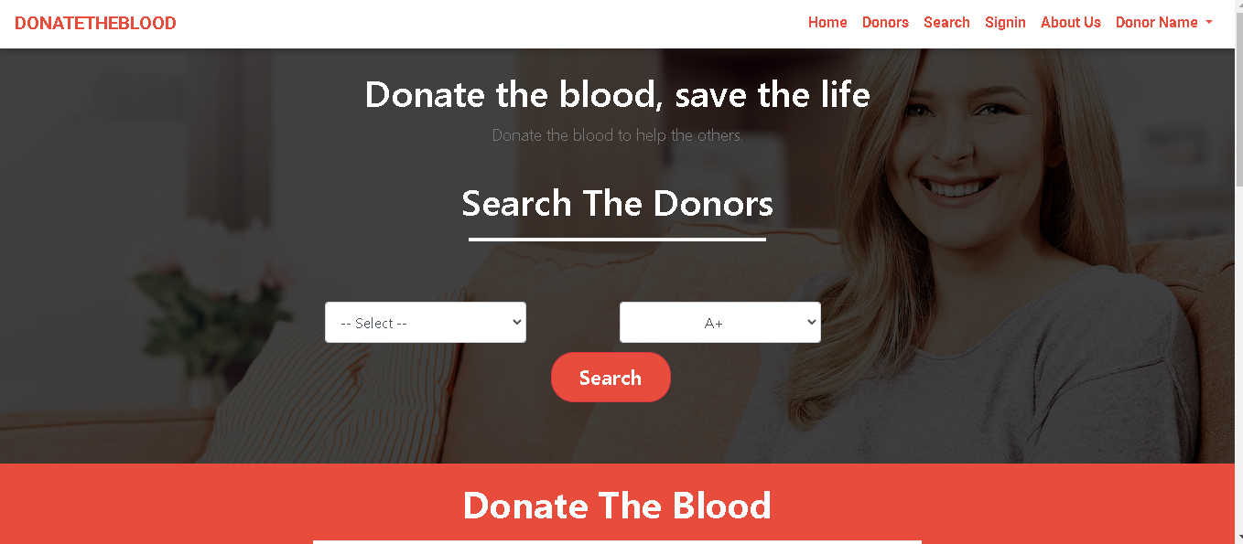
Introduction
Donate the blood is a platform to connect blood needy person to nearest donor without any medium person or blood bank.

Slide 4
PRIMARY GOALS
Get blood by location in real time.
Connect all for help each other.
Save time and save life.

Slide 5
Working
Sign-up
In portal
Join as donor/ needy person
Store data in database
Share contact

Slide 6
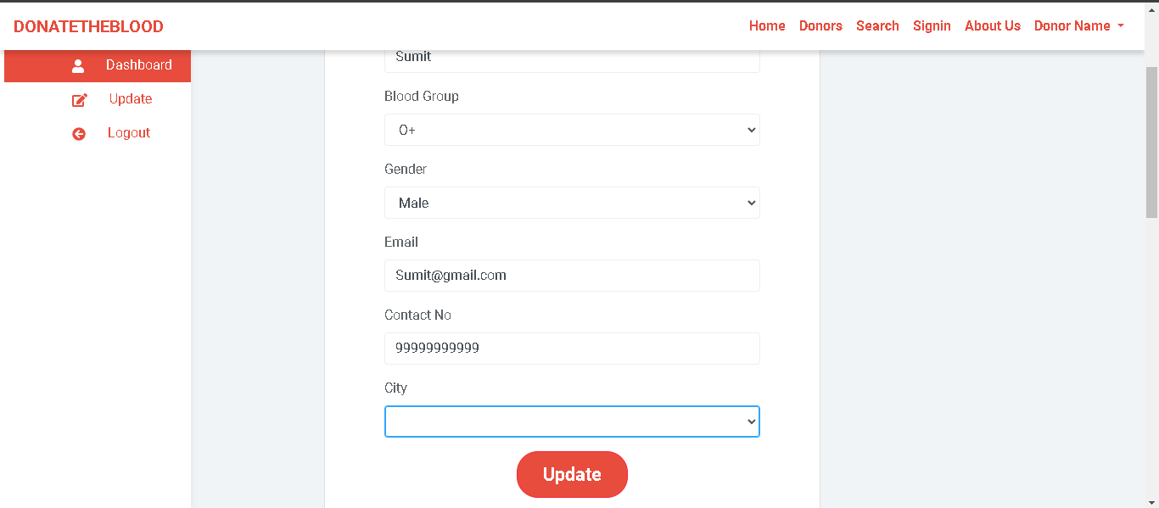
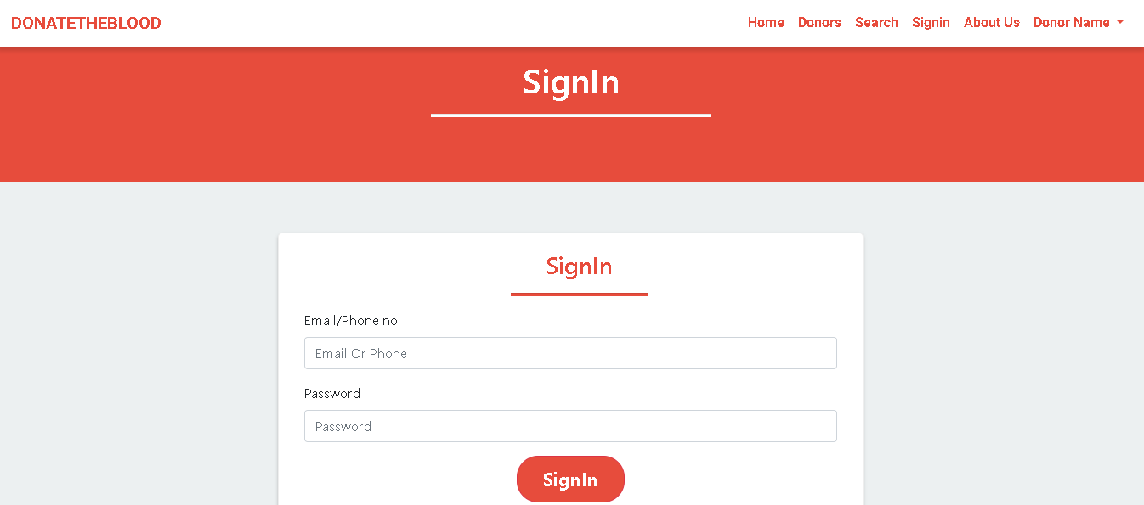
Out look UI/ux

Slide 7
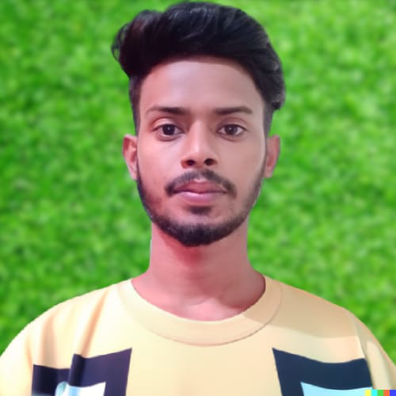
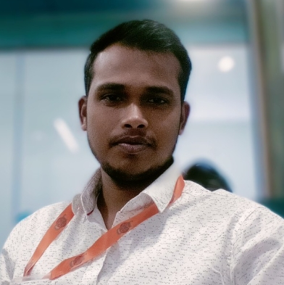
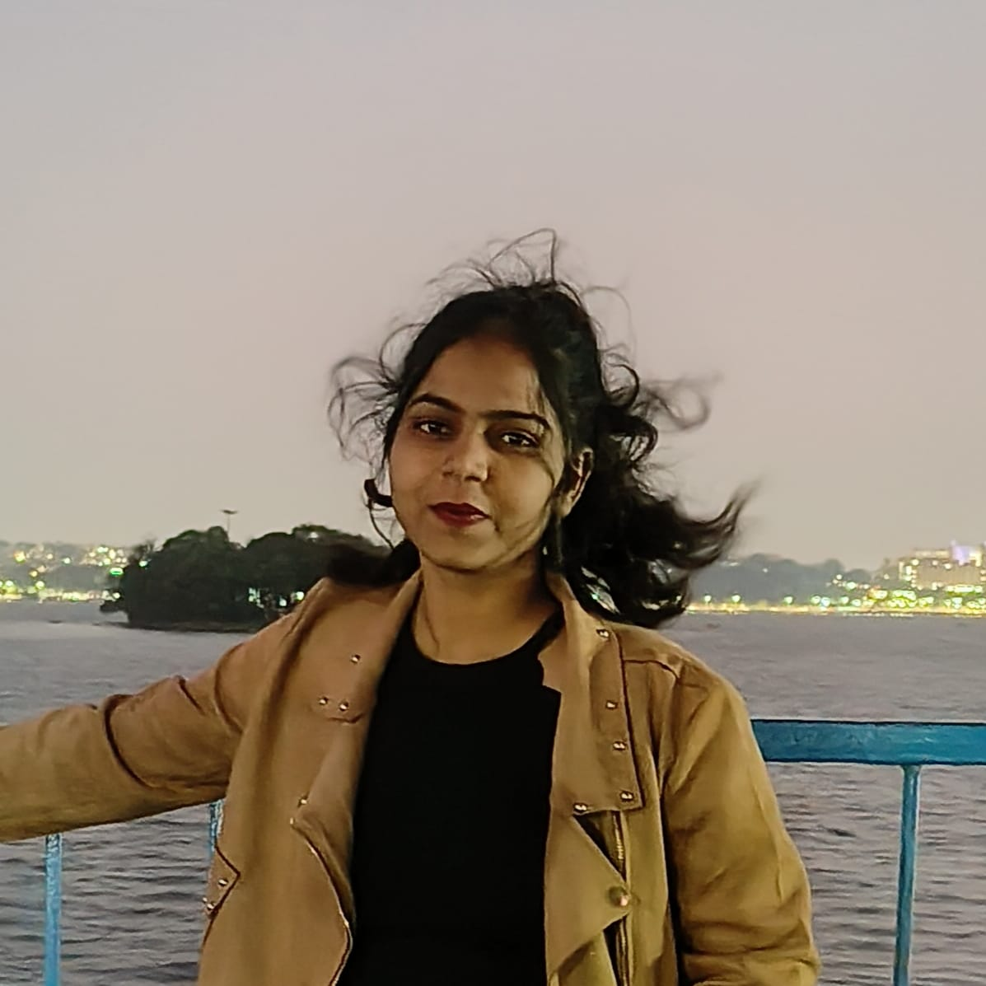
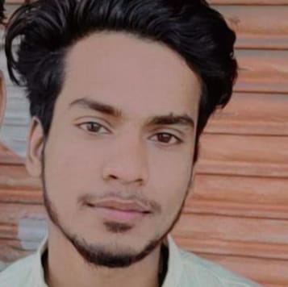
MEET OUR TEAM
Md Jabir Shah
Sumit Kumar
Pooja
AM Anisul QuaDRI​
Developer
Frond-end developer
Designer
Planner

Slide 8
SUMMARY
Social connection platform from blood relate problem. This project advantage is solving the problem of blood storing, collecting, managing

Slide 9
THANK YOU
Md Jabir Shah
jabirshah9080@gmail.com

